Slide 1
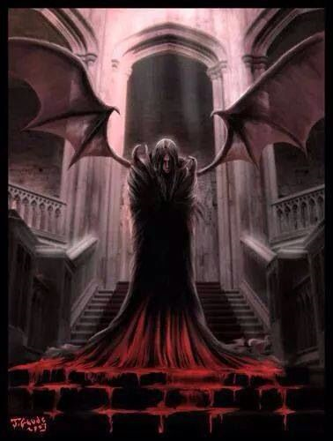
Twilight Hammer
Zachary Schmitz

Slide 2
Scenario
Story: Vampire wakes up from a long sleep and must fight the bandits that have taken over his castle
Genre: Medieval fantasy (brigands and archers)
Objectives: Kill enemies that have taken over your castle
Reach a distance of 7000 paces

Slide 3
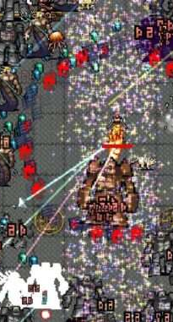
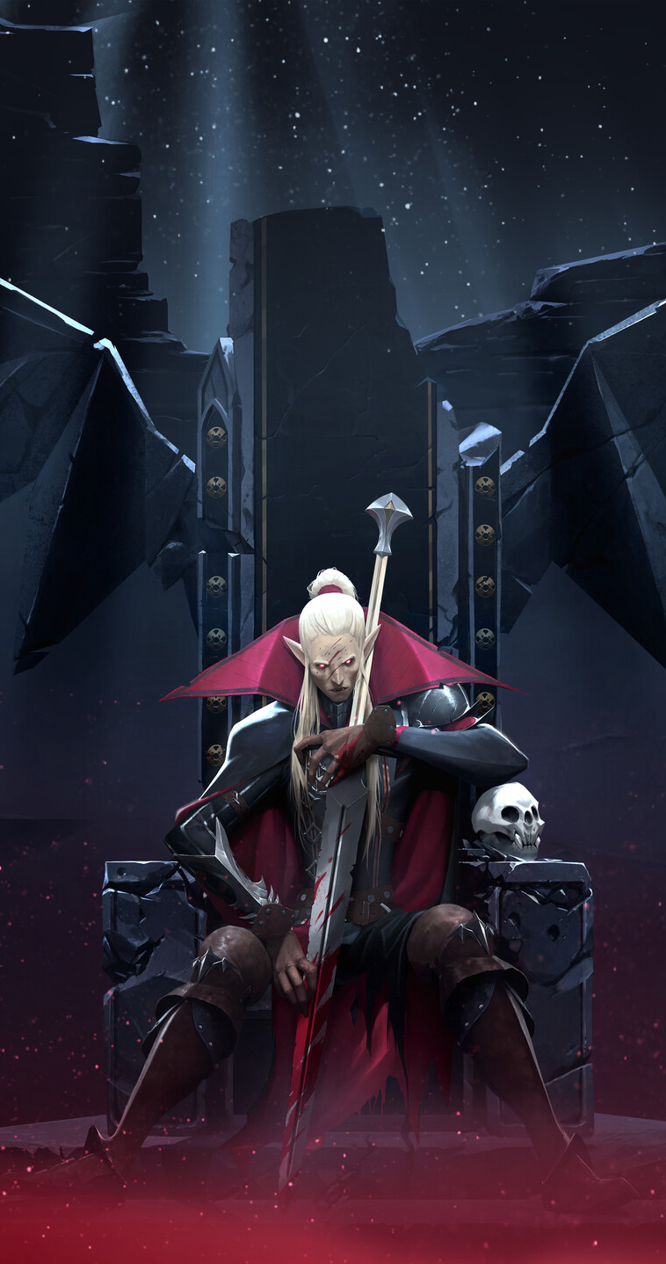
Inspirations
Setting and art inspired by V-Rising
Hordes of enemies like in vampire survivors
Dynasty Warriors player power (High impact/intensity)
Some styling from Warhammer fantasy (Vampire Counts)

Slide 4
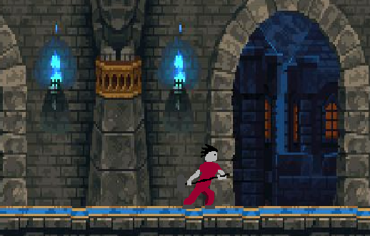
Information
Audience:
10-30 year old gamers
Probably male audience (mild violence)
Targeted toward high-action/high impact gamers
Not quite bullet-hell, but intending for lots of movement and action
Entities:
Vampire main character is bulky and strong with a hammer.
Enemy types are pawn and archer, with a boss of the pawn
Environment will your castle halls

Slide 5
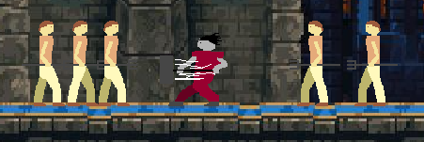
Game Mechanics
Multi-stage swing ground attack
Enemy maneuver and attack ai
Separate jump attack
Blocker zones (defeat all enemies to progress)
Tiny tutorial at the beginning.
Knock-back affects to launch hit enemies backwards variable distances

Slide 6
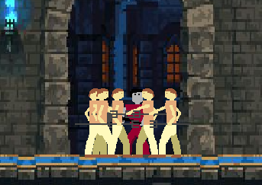
Enemy mechanics
Grunt:
Move to player location until in melee distance
Once in distance, swing
Get knocked back when hit
Archer:
Stays in position and fires. If within melee range will run away to safe distance.
Shoots straight arrows directly at players current position
Knocked back when hit

Slide 7
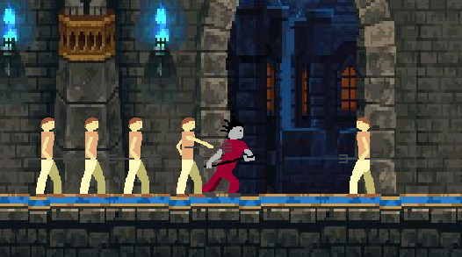
Technical components
Modules: Main, Player, Mobs, Bosses, Things
Levels: 1
Collision detection: simple distance math (Needs to run fast with many entities)
Physics: player jumping and arrow flights
Algorithms: character movement determination, AI maneuvering, melee distance calculations
Very simple AI and movements to allow more enemies!

Slide 8
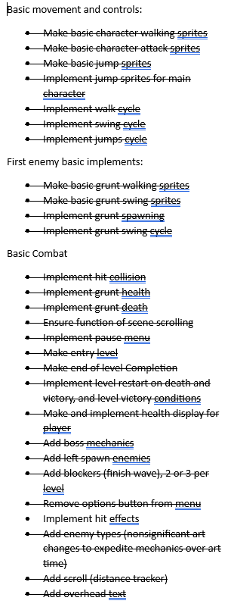
Timeline

